Slide 1




Final Project
Group 4

Slide 2


Good Morning!
Material of Presentation
DDL Create
Sequence and Explicit Index
DML Insert
Simple View
View

Slide 3






The Gentleman
Samuel Harlie
Marlion Malvin Chu
Nicholas
Marcelino
Raden Haryatama Astro

Slide 4
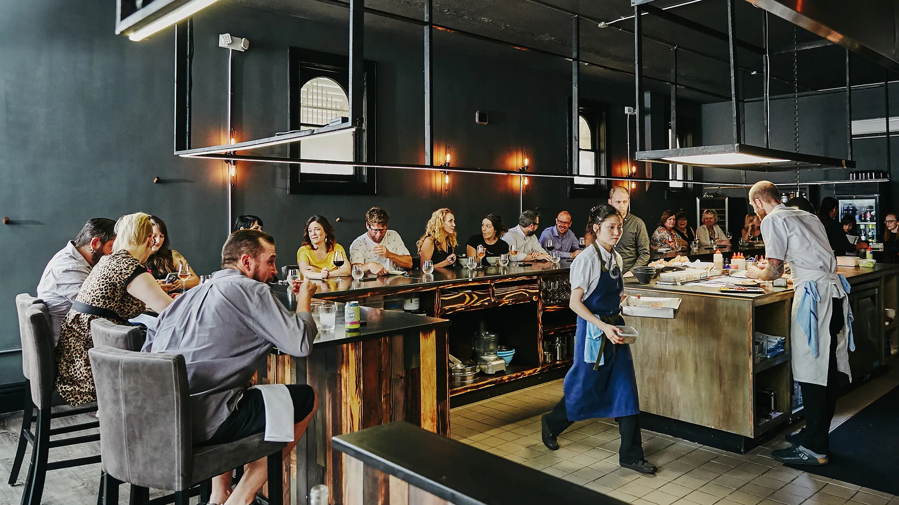
OUR BUSINESS

Slide 5



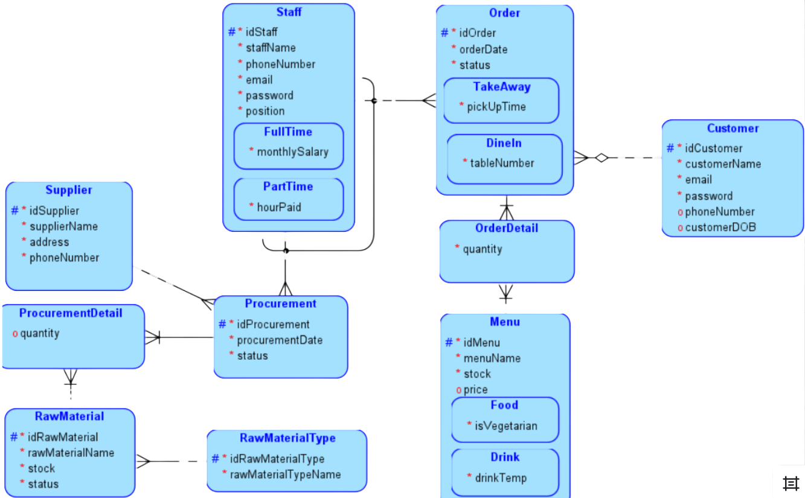
ERD

Slide 6

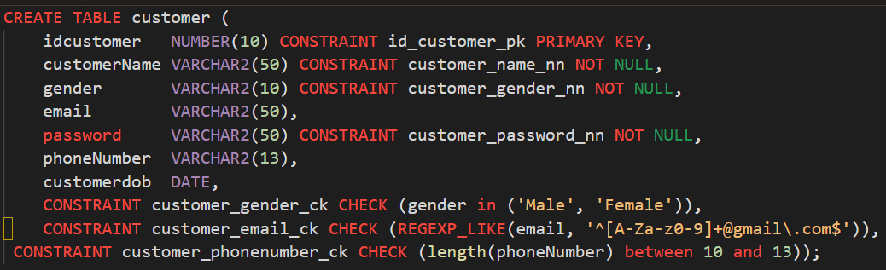

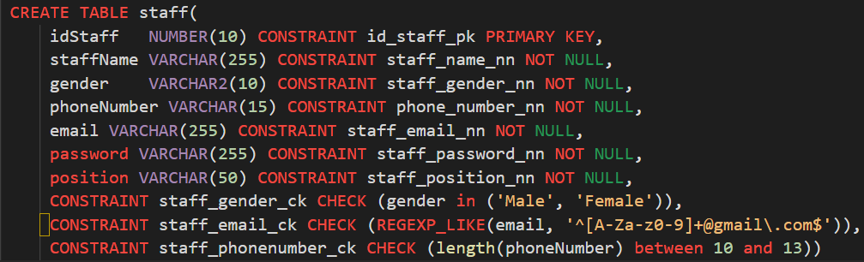
DDL
Customer
Staff

Slide 7

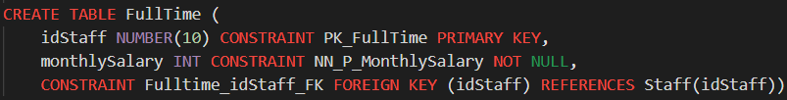

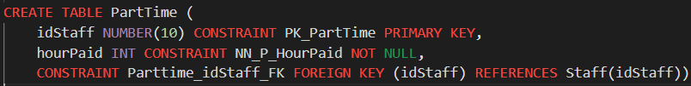
DDL
Full Time
Part Time

Slide 8

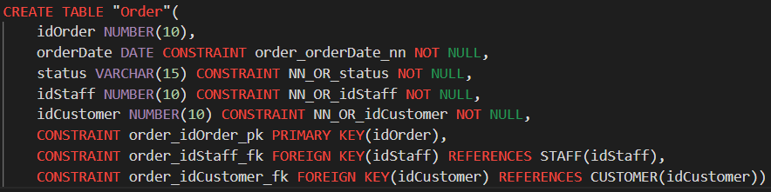
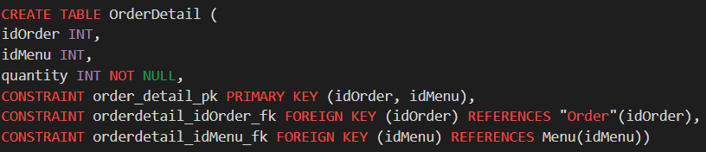
DDL
Order
Order Detail

Slide 9

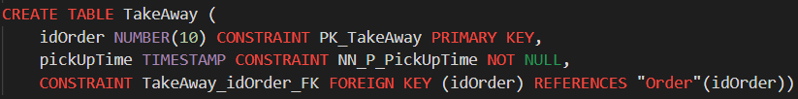

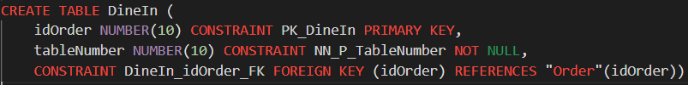
DDL
Take Away
Dine In

Slide 10
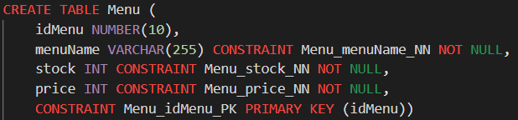
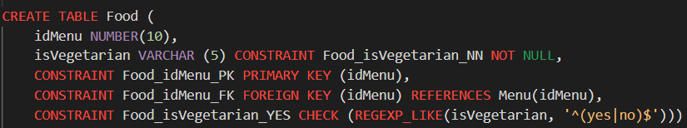
DDL
Menu
Food

Slide 11

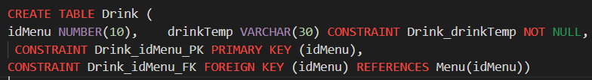

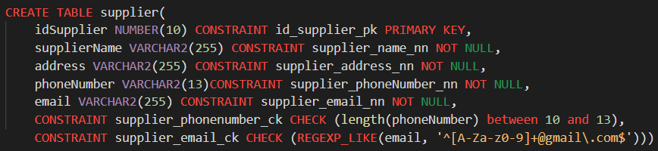
DDL
Drink
Supplier

Slide 12

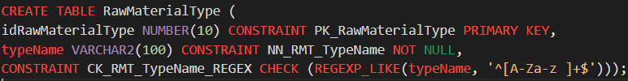
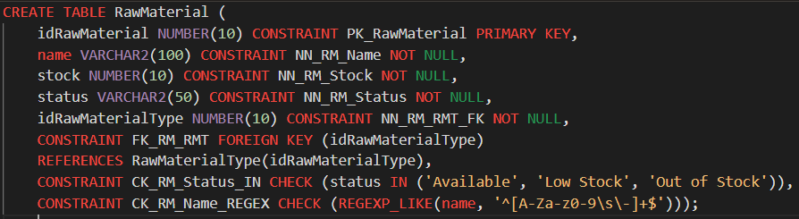
DDL
Raw Material Type
Raw Material

Slide 13

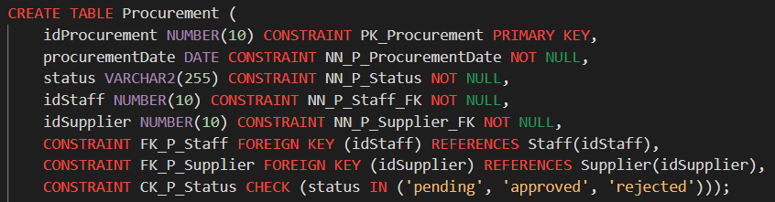

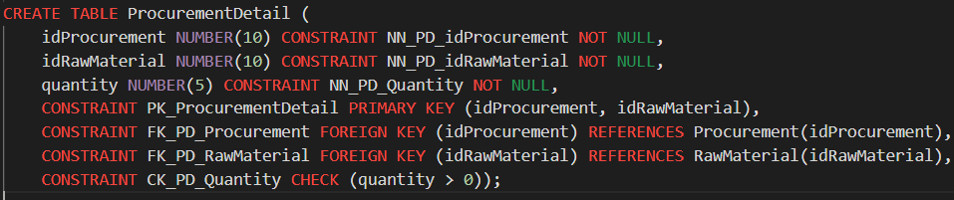
DDL
Procurement
Procurement Detail

Slide 14
Sequence and Explicit Index

Slide 15
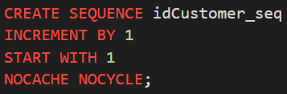
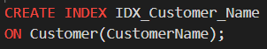
Customer
Sequence
Index

Slide 16
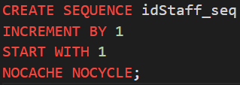
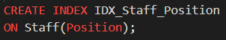
Staff
Sequence
Index

Slide 17
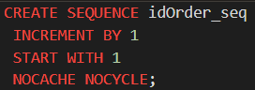
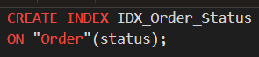
Order
Sequence
Index

Slide 18
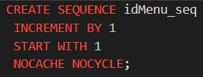
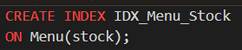
Menu
Sequence
Index

Slide 19
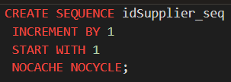
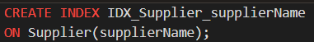
Supplier
Sequence
Index

Slide 20
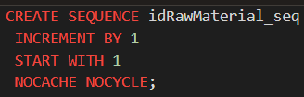
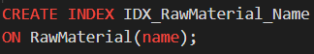
RawMaterial
Sequence
Index

Slide 21
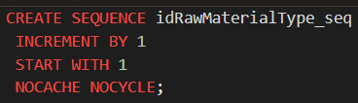
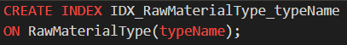
RawMaterialType
Sequence
Index

Slide 22
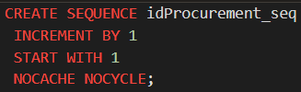
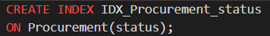
Procurement
Sequence
Index

Slide 23
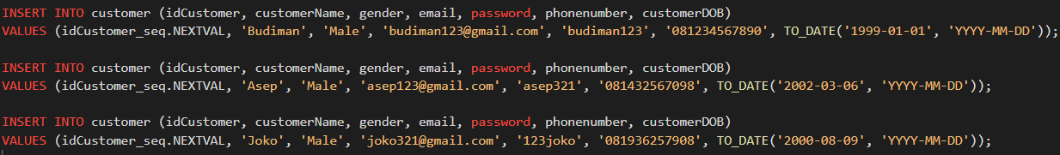
DML Insert
Customer

Slide 24
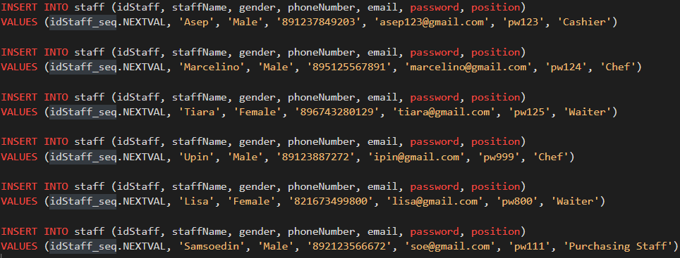
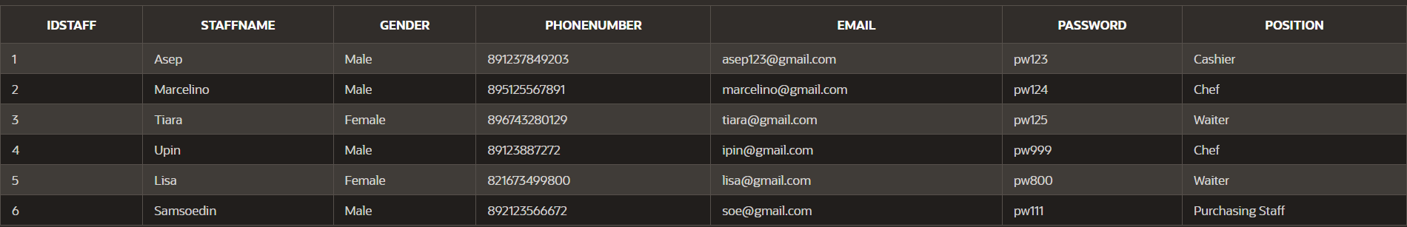
Staff

Slide 25
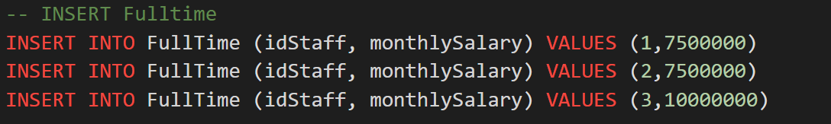
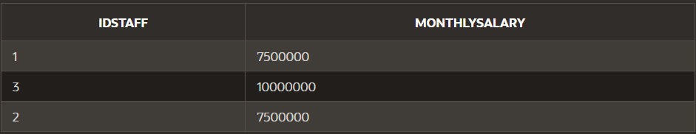
FullTime

Slide 26
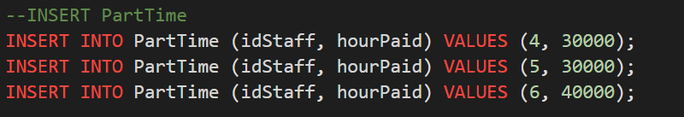
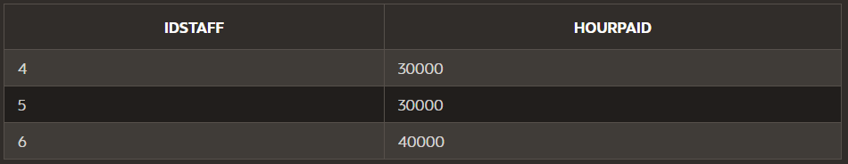
PartTime

Slide 27
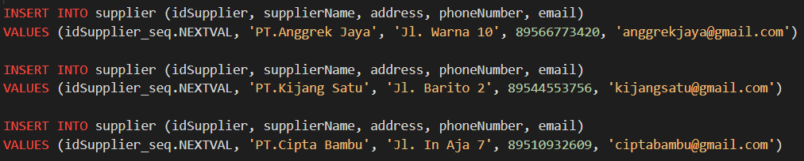
Supplier

Slide 28
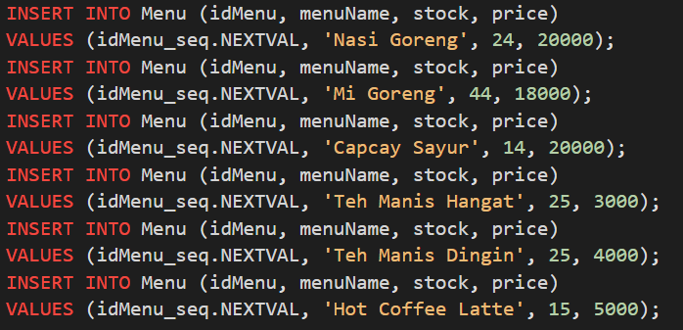
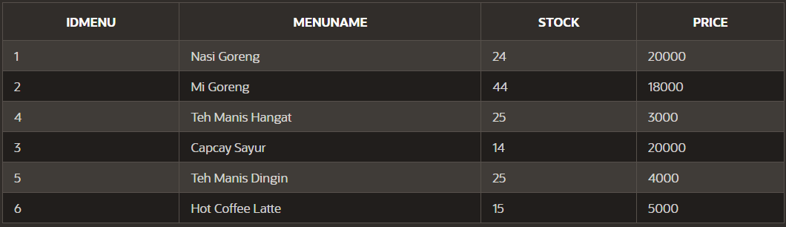
Menu

Slide 29
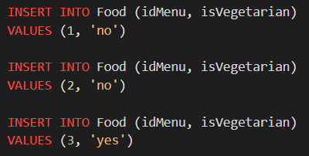
Food

Slide 30
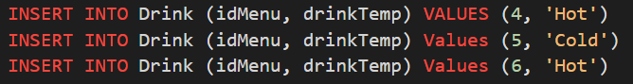
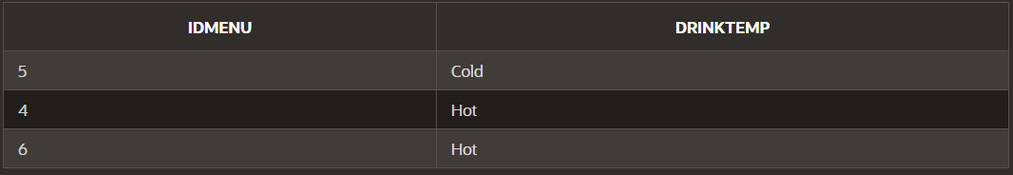
Drink

Slide 31
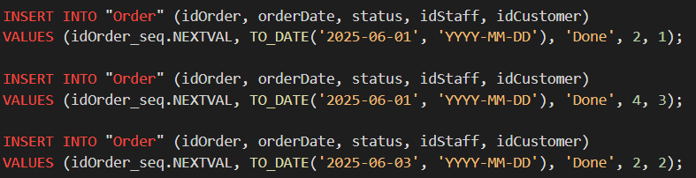
Order

Slide 32
OrderDetail

Slide 33
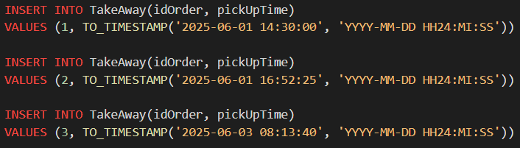
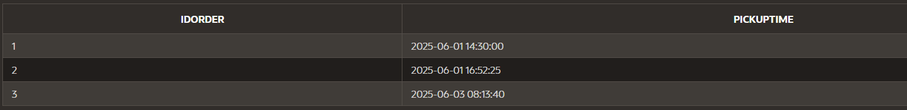
TakeAway

Slide 34

DineIn

Slide 35

RawMaterialType

Slide 36

RawMaterial

Slide 37

Procurement

Slide 38

ProcurementDetail

Slide 39
Simple View with Check Option

Slide 40



Slide 41
View (Outer Join & Set Operator)

Slide 42


Outer Join

Slide 43


Set Operator

Slide 44
View (Sub Query & Set Operator)

Slide 45

Sub Query
Untuk melihat menu yang memiliki jumlah stok dibawah rata-rata

Slide 46


Set Operator
Untuk melihat data staf yang belum pernah mencatat atau memiliki transaksi di tabel "Order".

Slide 47

Thank you!

